Slide 1



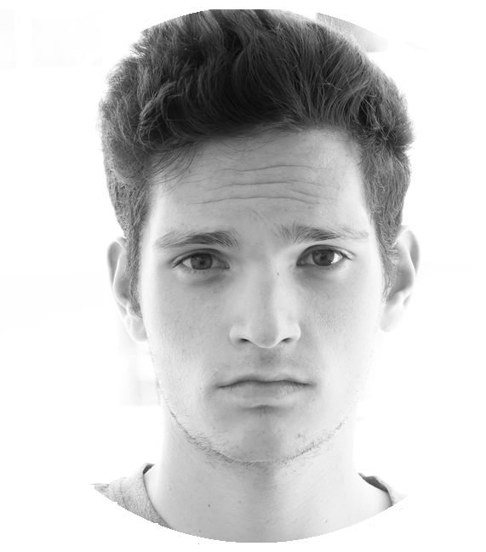
Light Networking (on the beach)
Kevin Kalish
José Ángel
Morell Martínez
Cristobal Gonzalez
Quino Terrasa

Slide 2
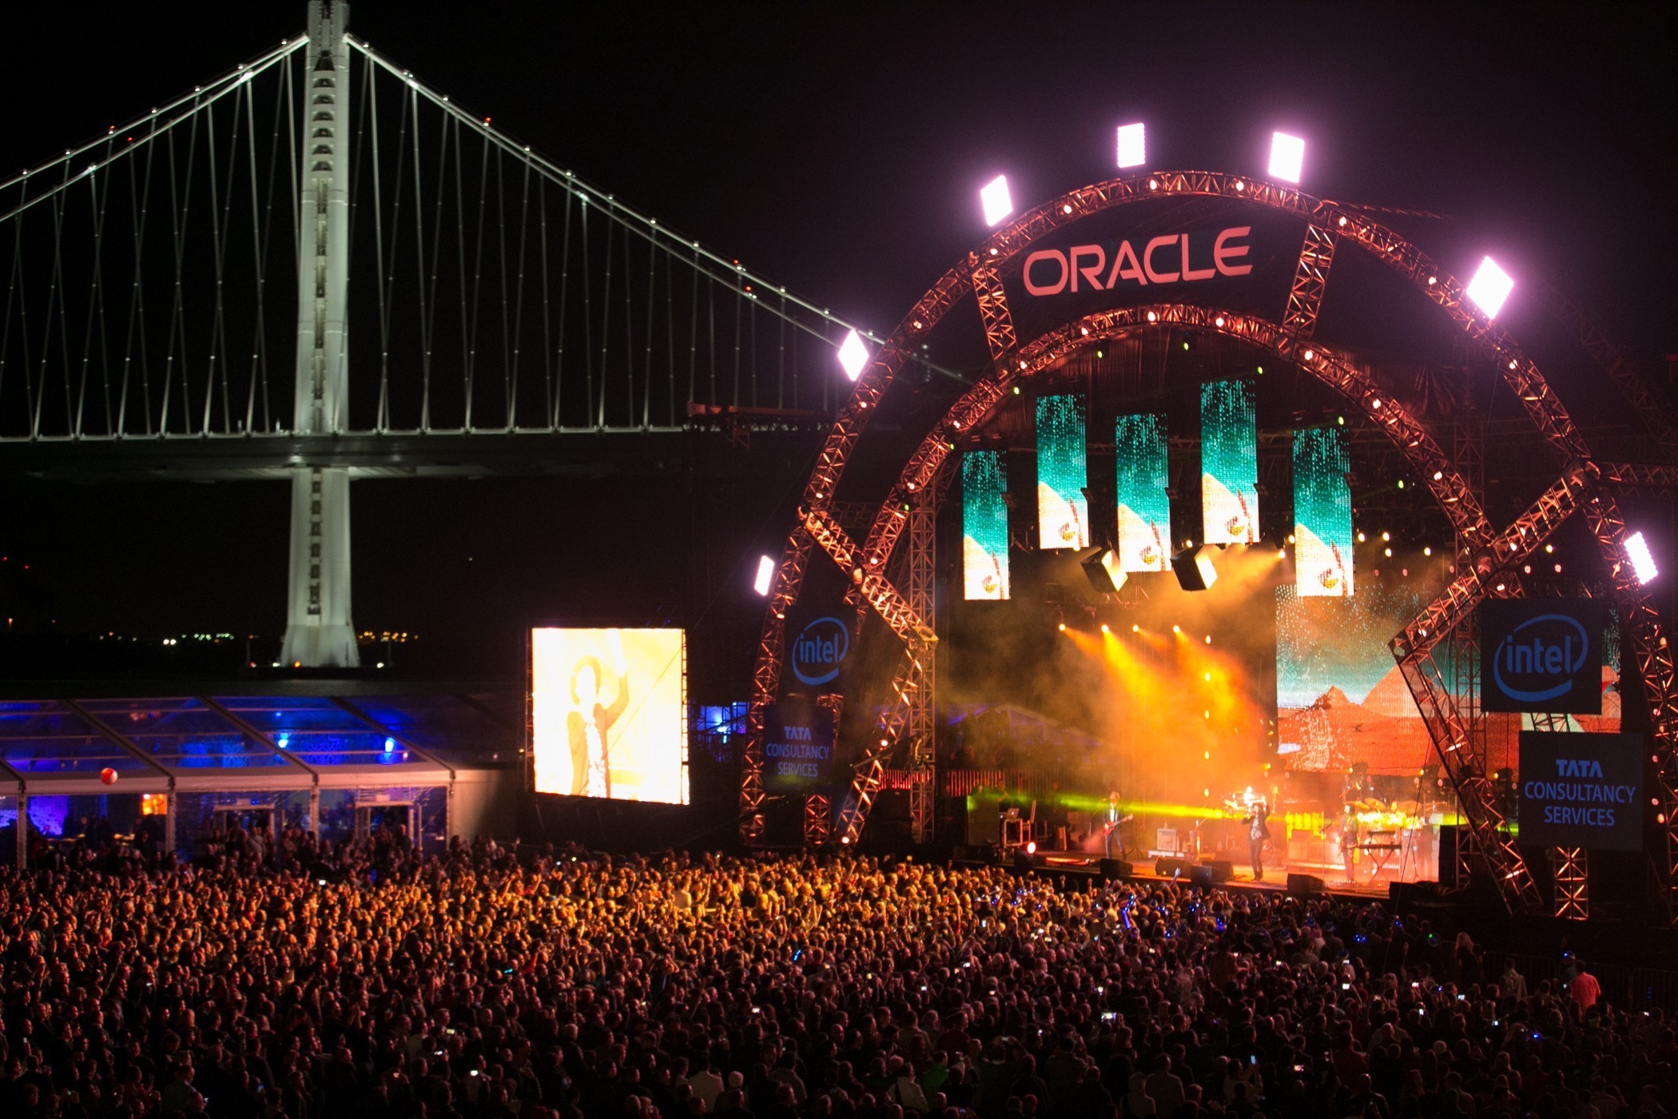
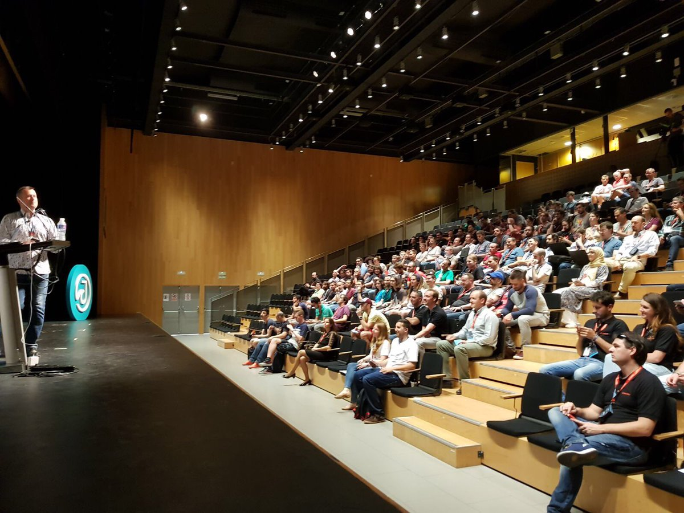
The problem with networking at conferences
Light networking
On the beach
Who should I speak to at the event?
How do I get others to know who I am ?
I’m shy!
Notes:
The problem we wanted to solve is one that we experienced in many conferences, and you may have experienced even in this conference too
And it’s about effective networking.
Who should I speak to at the event? How do I get others to know who I am ? Maybe I’m shy and don’t know how to initiate conversations.
This problem becomes worse, the bigger the conference [click] – for example OpenWorld which has over 50,000 people attending it.

Slide 3


Wouldn’t it be great if we all advertised
what we are really at this conference for?
Light networking
On the beach
Notes:
Wouldn’t it be awesome if as we check-in, we will get a customised t-shirt that articulates exactly what we’re trying to get out of this conference ?

Slide 4
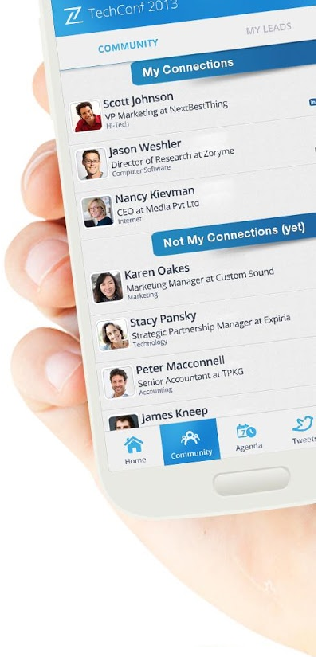
The problem with networking applications
Light networking
On the beach
Technical barriers (social media is not for everyone!)
Scroll through too many people
It’s time consuming & you end up not meeting anyone
Notes:
Of course the conference has an app that tries to solve this problem … but these apps are far from perfect.
Believe it or not there are many non-technical people attending conferences
You could end up scrolling through thousands of people
It is time consuming and you may actually end up not meeting any of your targeted individuals.

Slide 5
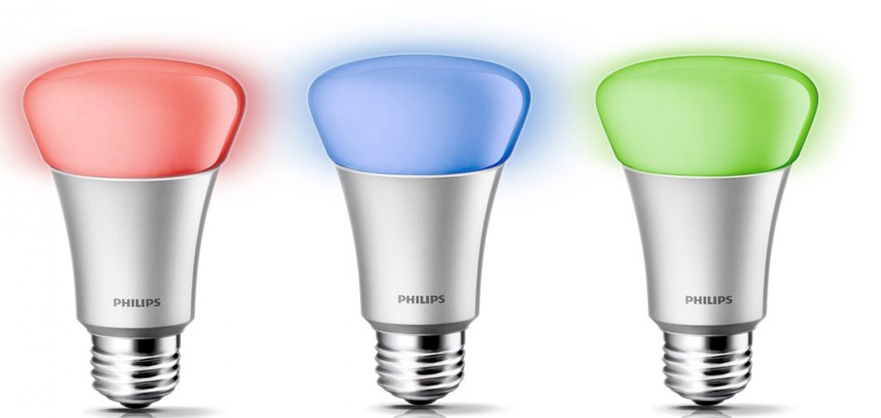
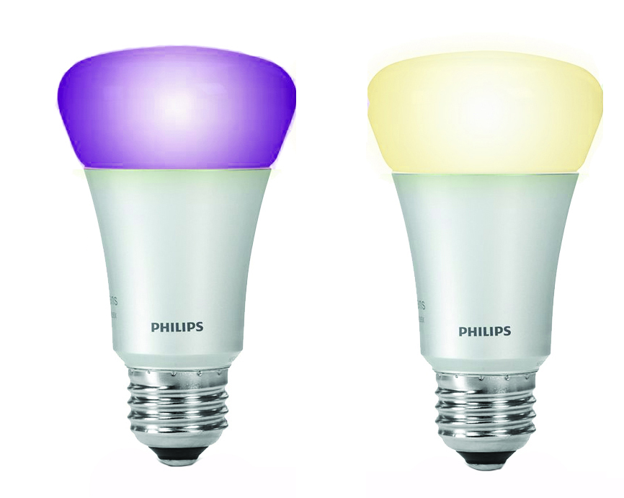
Light networking
On the beach
Our Solution
Valuable business connections in the real world
Notes:
The solution we developed over the last 2 days, is to create valuable business connections in the physical world.

Slide 6
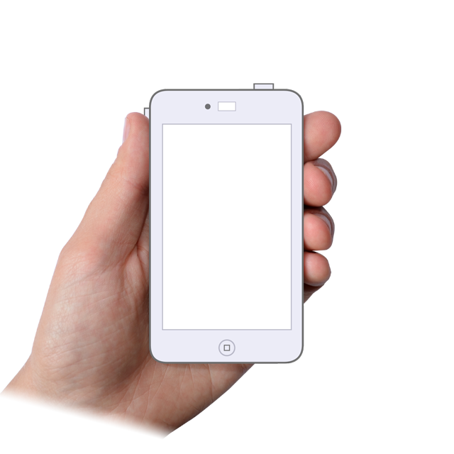









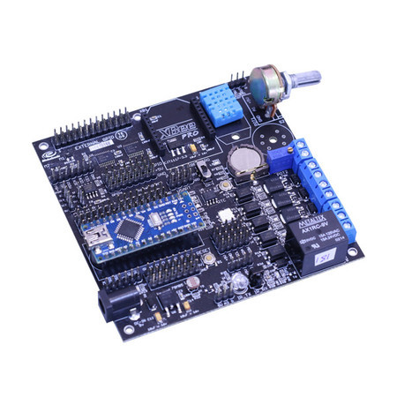

Light networking
On the beach
Valo Stream: Location, Skills,
Demographics ….
…
Notes:
So how does it work?

Slide 7
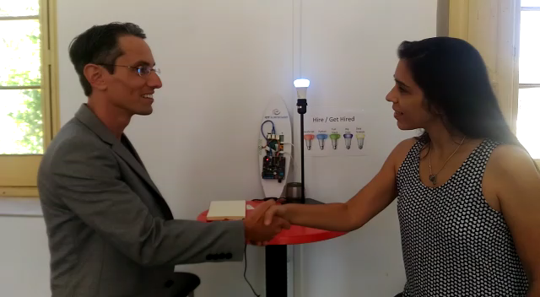
Light networking
On the beach

Slide 8
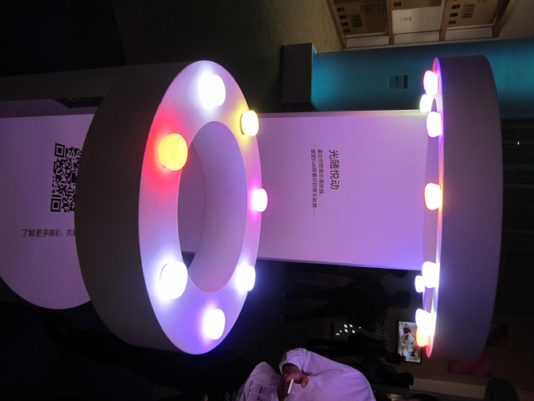

Different stations to achieve different goals
Talk Case Studies
Hire / Get Hired
Learn New Skill
Visualisation
JS
Learn New Skill
Hadoop
Spark
PHP
Find Customers
Find an Industry Expert
Connect With Peers

Slide 9
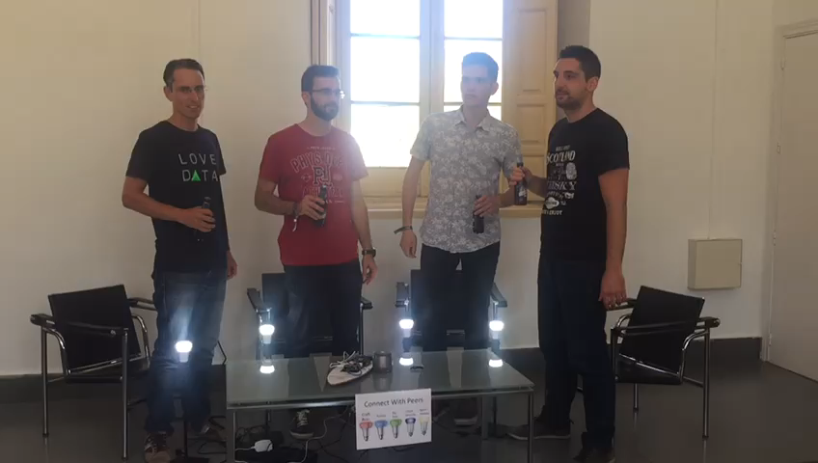
Light networking
On the beach

Slide 10
Light networking
On the beach
We collect this real-time data .. What can we do with it?

Slide 11
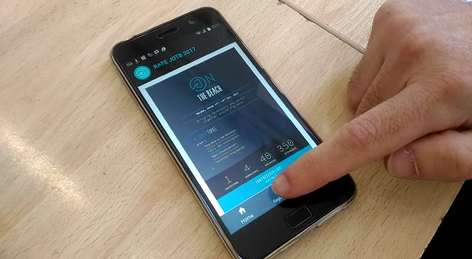
Light networking
On the beach

Slide 12
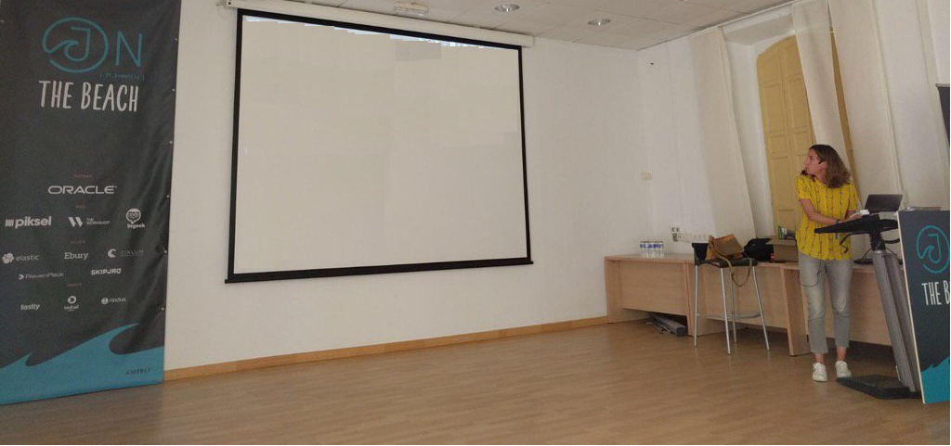
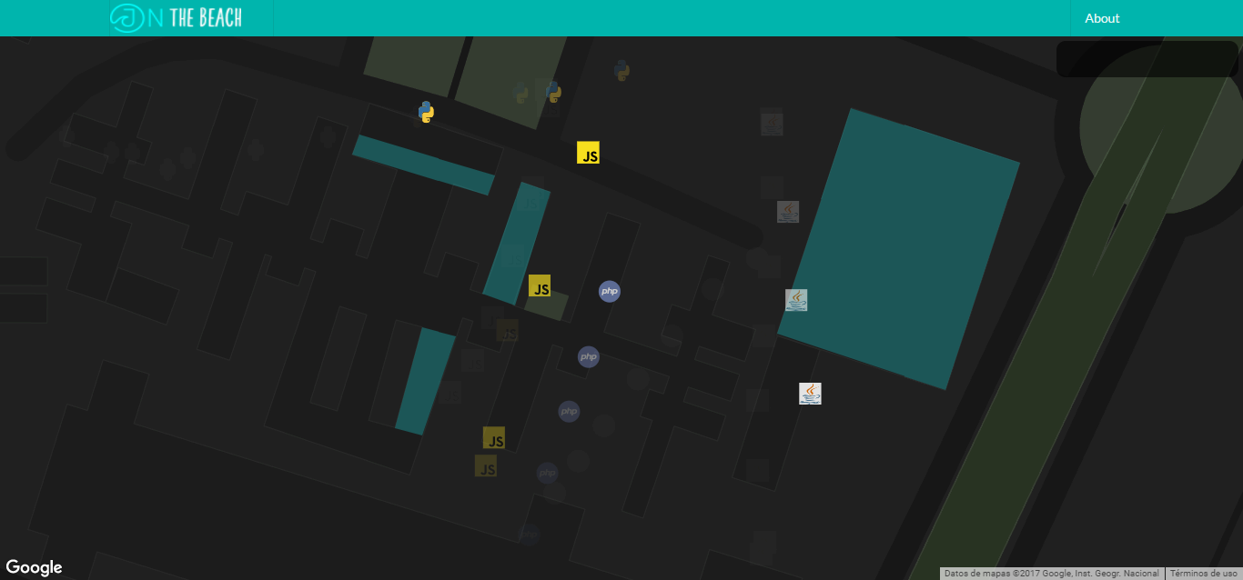
Light networking
On the beach
Where are “my people” congregating right now?

Slide 13
Light networking
On the beach
Now that the organizers collect this data.. What insights and value can they extract?

Slide 14
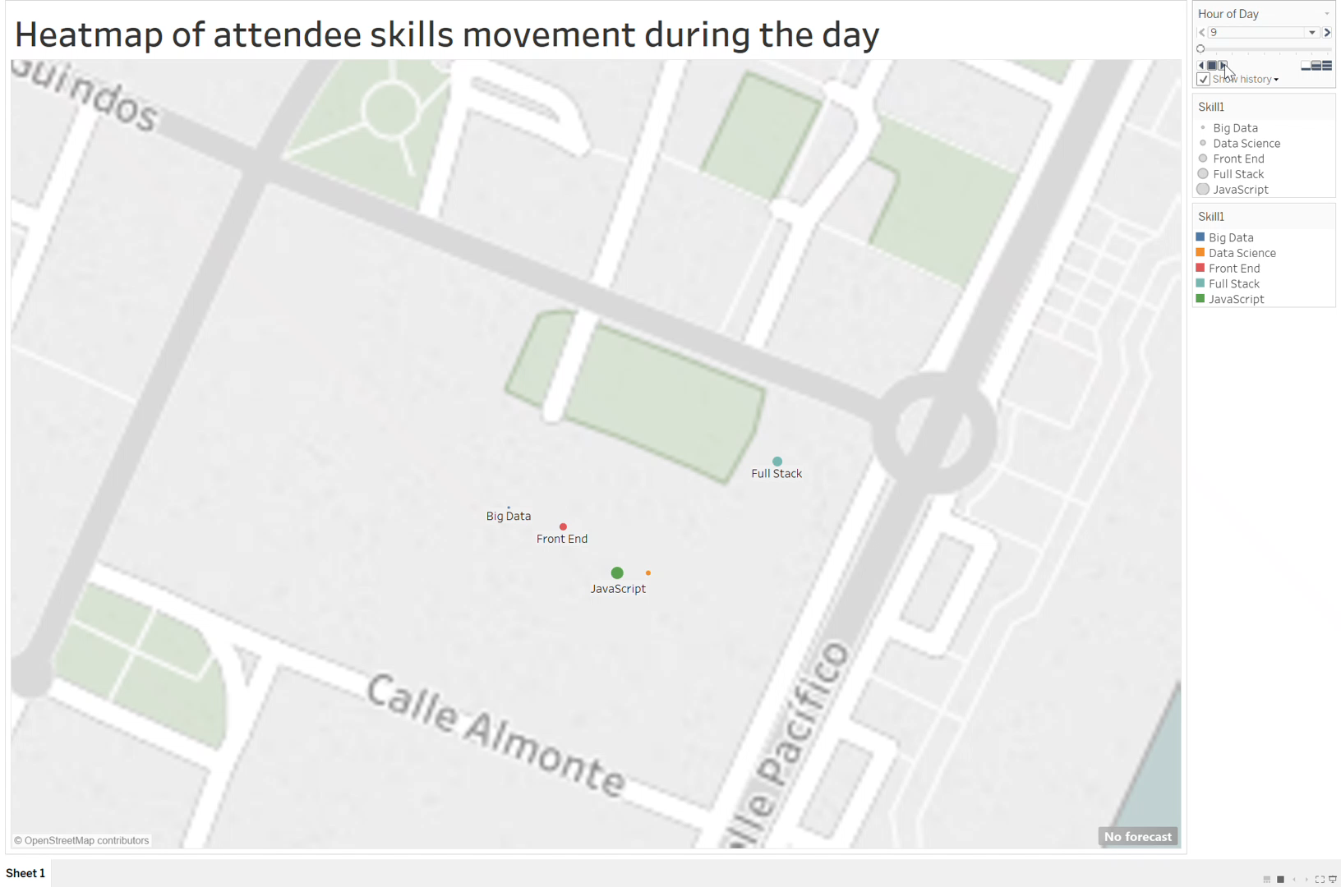




Notes:
Here’s aggregating all the real-time data collected during the first day of conference, and showing you just one simple example of how this can be visualised to get some business value.
This will animate the movement of people with a certain skill, through the conference venue throughout the day – you can see the time of the day changing on the top right corner.

Slide 15
Premium services
Light networking
On the beach
Crowd intelligence to exhibitors, for e.g.:
Segmentation of pass-bys at different times of the day
Forecast Day-2 people movement (by skill / goal / demographic) based on Day-1 data
And even more!

Slide 16
In Summary :
Light networking
On the beach
Get more from attending a conference
Innovative, fun and engaging for participants
Valuable intelligence for exhibitors
Organizers can sell premium analytics services

Slide 17

We hope you had a lightbulb moment
Light networking
On the beach
We are Light networking. THANK YOU!

